Slide 1
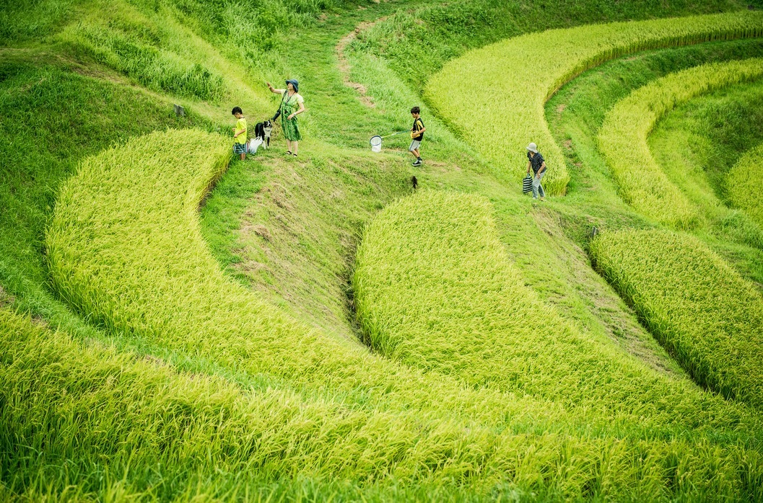


Slide 2

What is techric ?

Slide 3


Is a system to remotely monitor rice fields water level

Slide 4
Why do we
need ?

Slide 5
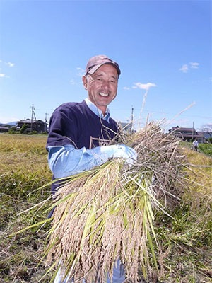
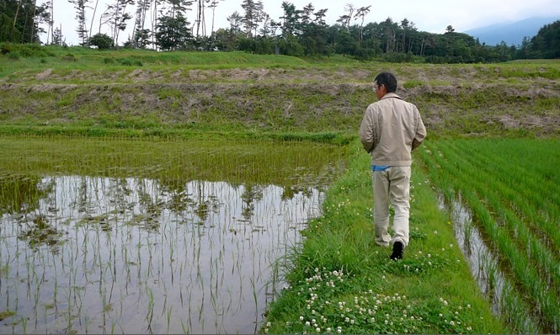
Tanaka-san, 74歳
He loves growing rice

Slide 6
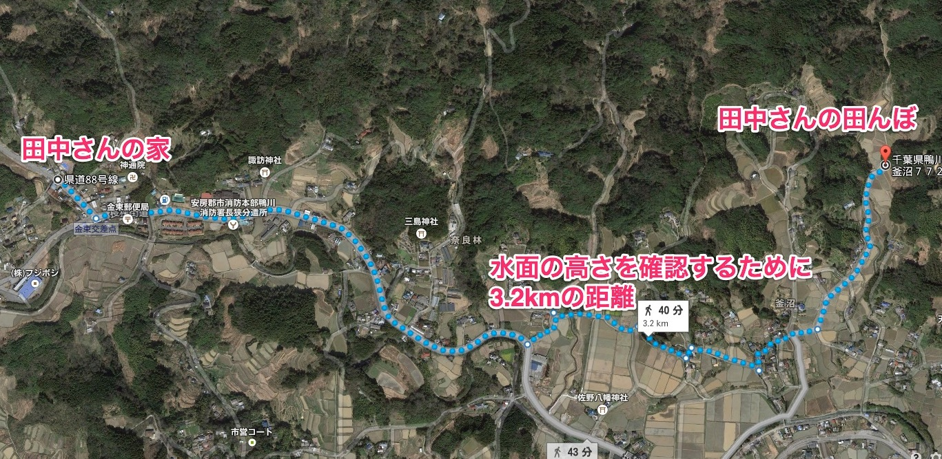
Going by car to check the water level takes 10 minutes every day
3,2km away

Slide 7
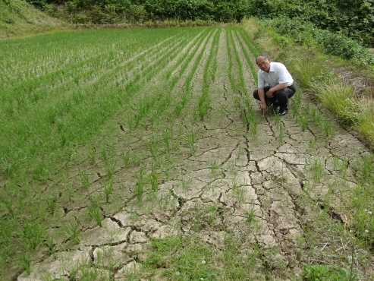
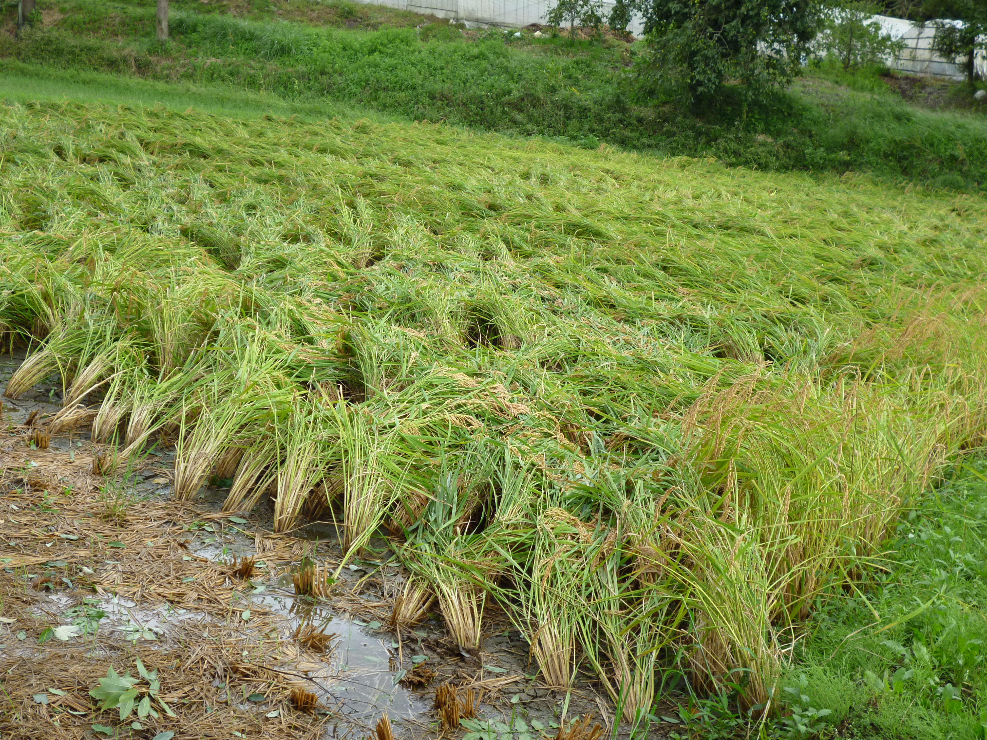
田んぼのメンテをちゃんとやらないと生産性が下がります

Slide 8
Tanaka-sanの田んぼ一年間の生産
ちゃんとに運用する場合 | 適当に運用する場合
コシヒカリ１００Kg | コシヒカリ60Kg

Slide 9
Tanaka-san is getting old and sometimes he doesn’t go to check the rice field for days
水面のレベルを確認するのは「面倒くさい！」

Slide 10

Tanaka-san doesn't have to go to the rice field to check the water level everyday
Using
A畑の水面の高さが低すぎます！
らくちん！

Slide 11
How does techric work?

Slide 12
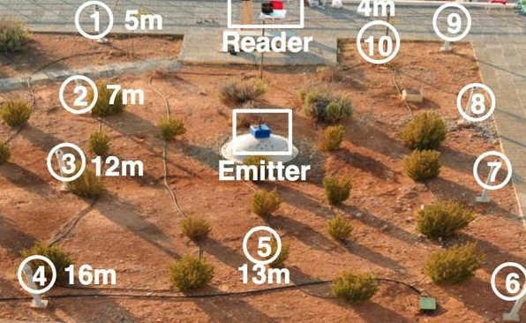
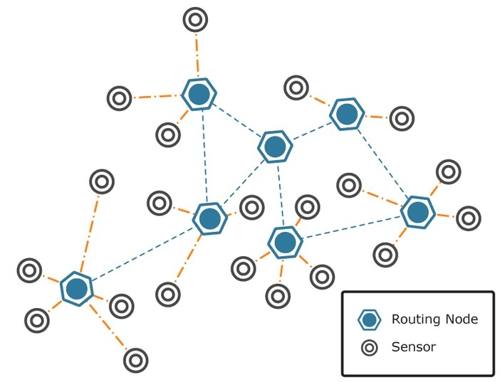
Building a low cost, low power sensor network

Slide 13
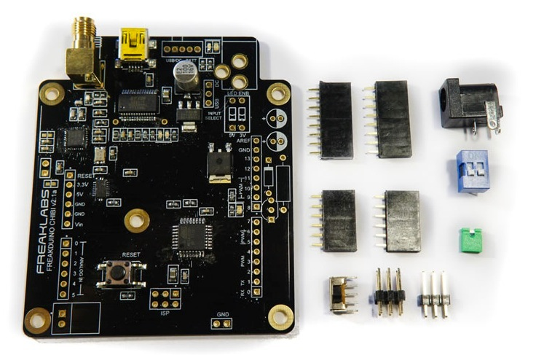
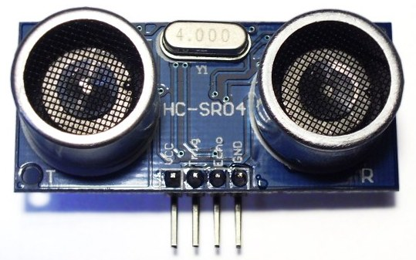
900Mhz 802.15.4
Using Freaklabs 802.15.4 open hardware. Long range &
low power
ATMega 328 processor, 8Mhz
Sonar to
measure
water level

Slide 14
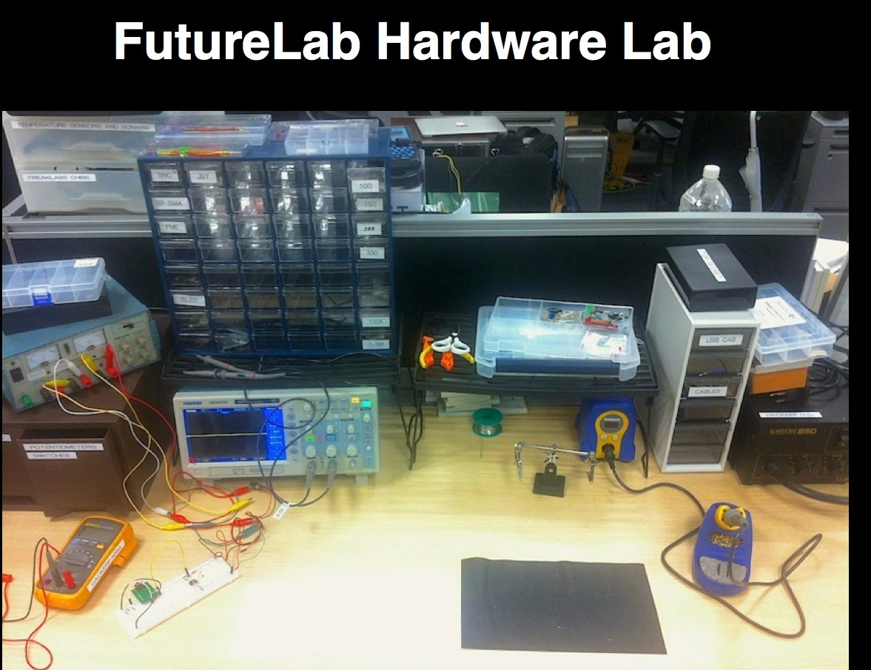

Slide 15
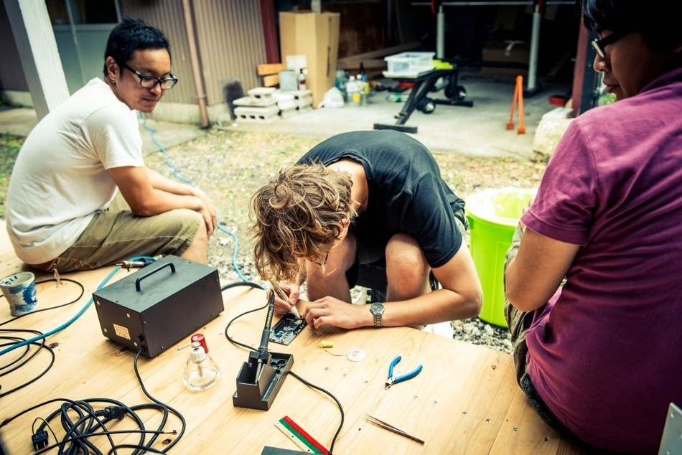
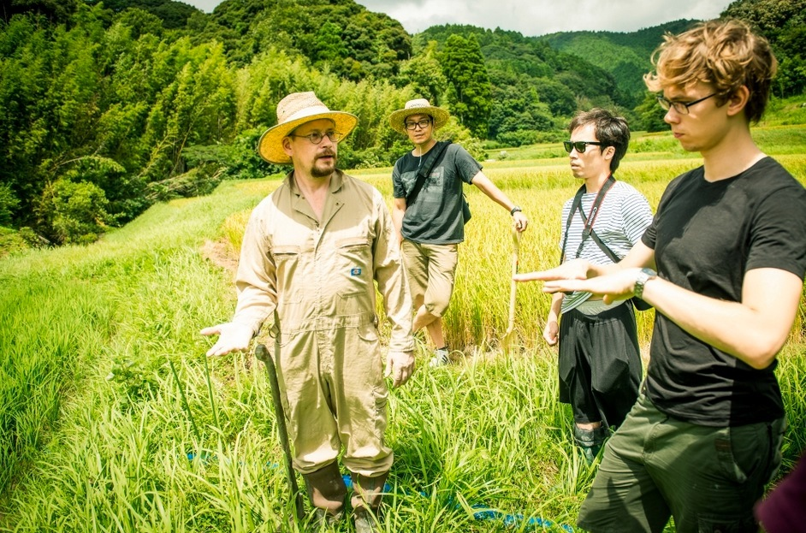
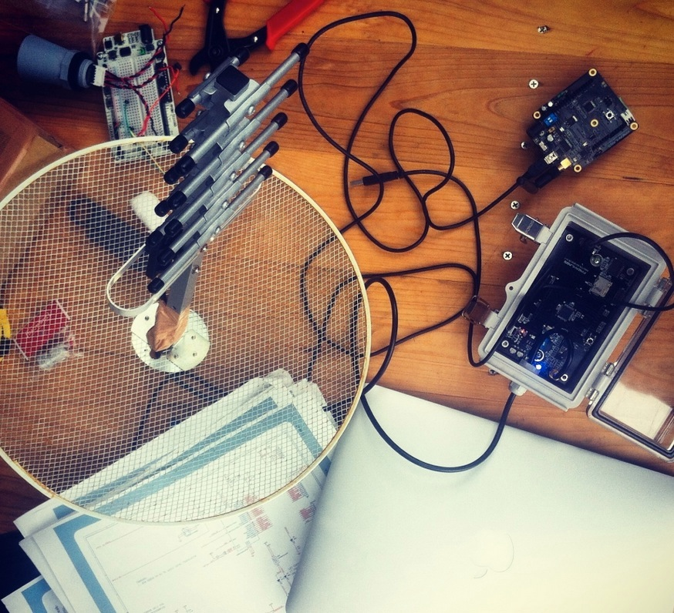
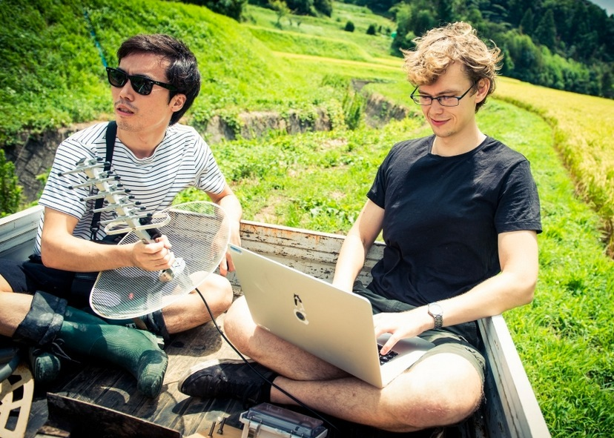
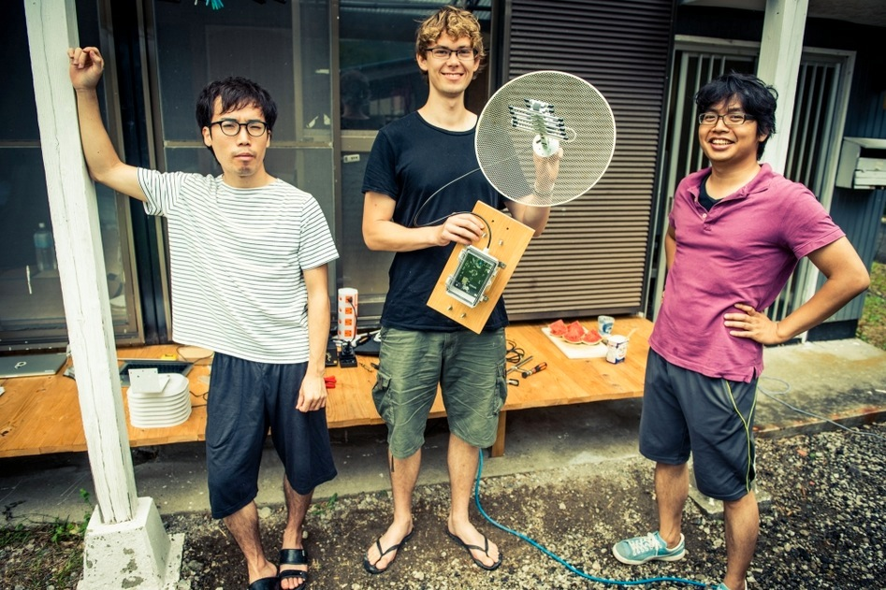
Building our first prototype at Hacker Farm

Slide 16
Demo

Slide 17
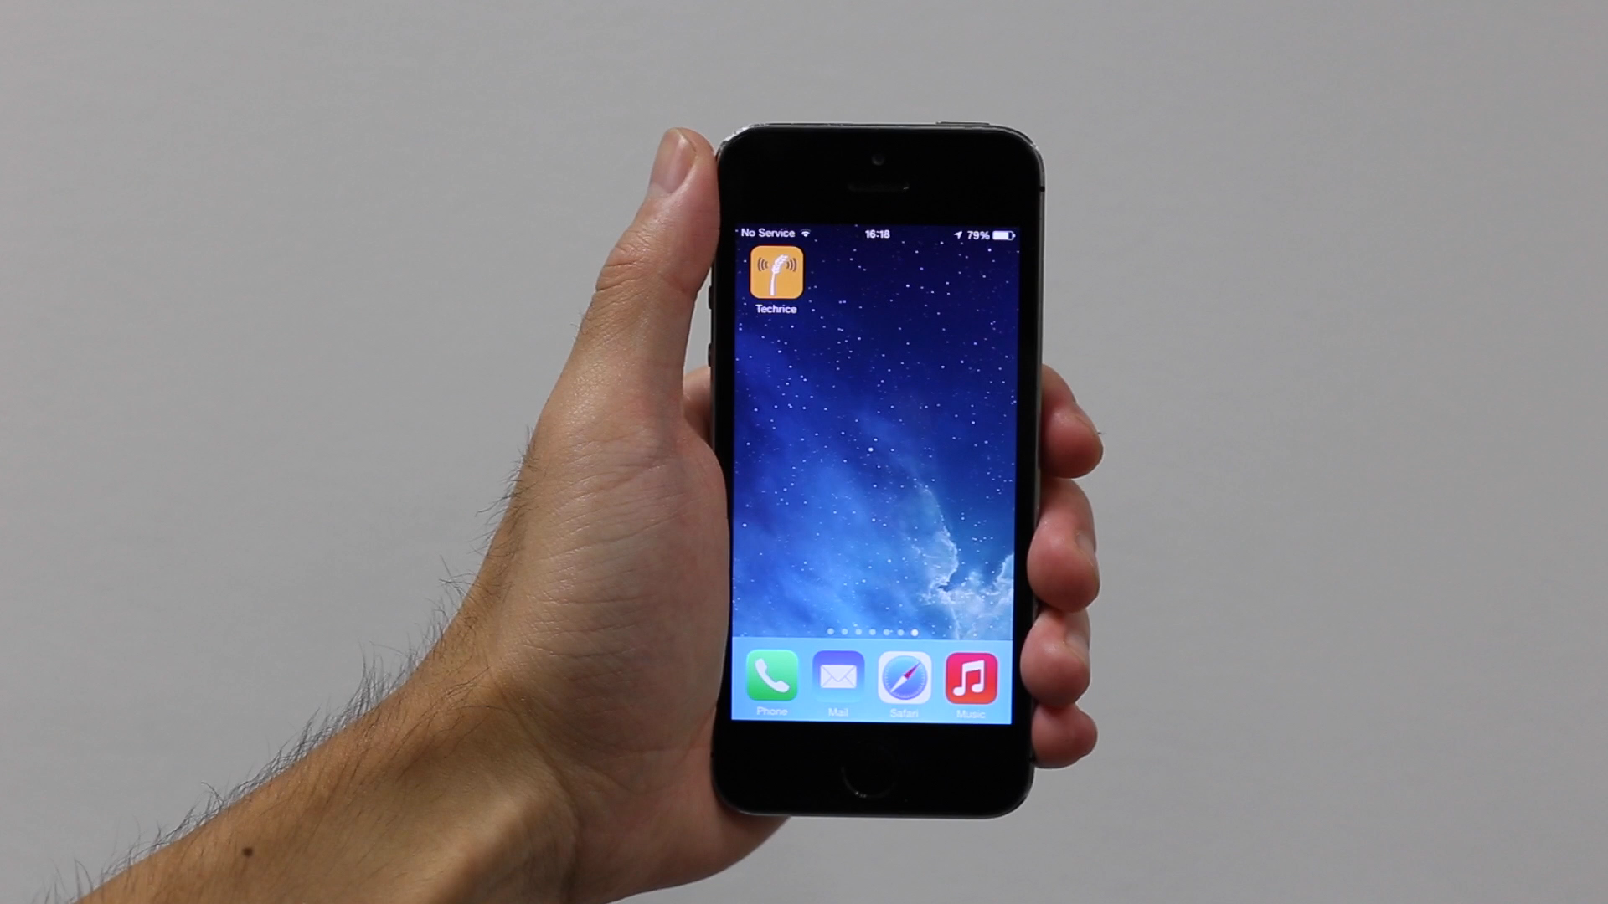

Slide 18

